Slide 1
Medicare 101:
The Basics of Medicare
Presented by:
WE DO NOT OFFER EVERY PLAN AVAILABLE IN YOUR AREA. CURRENTLY WE REPRESENT [INSERT NUMBER OF ORGANIZATIONS] ORGANIZATIONS WHICH OFFER [INSERT NUMBER OF PLANS] PRODUCTS IN YOUR AREA. PLEASE CONTACT MEDICARE.GOV, 1-800-MEDICARE, OR YOUR LOCAL STATE HEALTH INSURANCE PROGRAM (SHIP) TO GET INFORMATION ON ALL OF YOUR OPTIONS.

Slide 2
Medicare Basics
How to Qualify
People who are age 65 and over
People under age 65 with certain disabilities
People with End Stage Renal Disease (ESRD)

Slide 3
Medicare Basics
How to Enroll
Enrollment is automatic if receiving Social Security benefits at least 4 months prior to Medicare eligibility
If not receiving SS benefits:
Apply Online Through Social Security Website
Visit Local Social Security office
Call Social Security

Slide 4
Medicare Basics
Delaying Enrollment Past Age 65
Most individuals enroll in Part A (no cost)
Enrollment into Medicare Part A makes you ineligible to contribute to an HSA
Those with other coverage may delay Part B (coverage must be due to active employment through self or spouse)
Part B enrollment would be the 1st of the month following last day of employer coverage
No late enrollment penalty for Part B or Part D with creditable coverage
COBRA is not considered creditable coverage per Medicare guidelines for Part B

Slide 5
What Is Medicare
Part A – coverage
Inpatient care in a hospital
Skilled nursing facility care
Inpatient care in a skilled nursing facility (not custodial or long-term care)
Hospice care
Home health care

Slide 6
What Is Medicare
Part A – premium
Free if you and/or your spouse have a combined 40 or more working quarters where you have paid Medicare taxes – either through employer payroll deduction or paid in via taxes if self-employed
Those without 40 working quarters can still get Part A, but they will pay a premium

Slide 7
What Is Medicare
Part B – coverage
Outpatient care
Preventative services
Doctor’s visits
Diagnostic tests
Therapies
Durable medical equipment
Ambulance services

Slide 8
What Is Medicare
Part B – premium
Standard Monthly - $174.70
May be more depending on income
IRMAA (Income Related Monthly Adjustment Amount)

Slide 9
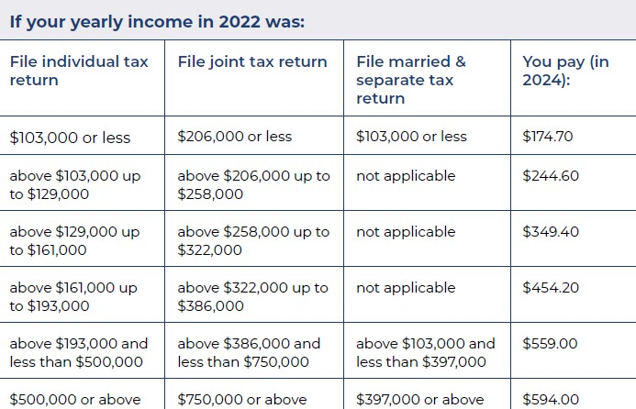
Income Related Monthly Adjustment Amount

Slide 10
What Is Medicare
Part B – enrollment periods
Initial Enrollment Period (IEP)
3 months before, the month of, and 3 months following 65th birthday
Special Enrollment Period (SEP)
Loss of creditable coverage
General Enrollment Period (GEP)
January 1 – March 31; effective first of the following month

Slide 11
What Is Medicare
Part B late enrollment penalty
10% of the standard premium for each 12-month period you were eligible for Part B but did not sign up
Penalty is waived if covered through active employment
If you receive a late enrollment penalty, you will have to pay it as long as you have Part B

Slide 12
What Is Medicare
Part A – cost sharing
Hospitalization
$1,632 deductible for first 60 days of inpatient hospital stay; additional costs after 60 days
Skilled Nursing Care
First 20 days covered if Medicare requirements met
$204 per day for days 21-100 in skilled nursing facility

Slide 13
What Is Medicare
Part B – cost sharing
Annual Deductible - $240
20% coinsurance once annual deductible is met
No out-of-pocket maximum

Slide 14
Prescription Drug Plans
Part D - coverage
Standard benefit design
Deductible
Initial coverage
Coverage gap
Catastrophic coverage

Slide 15
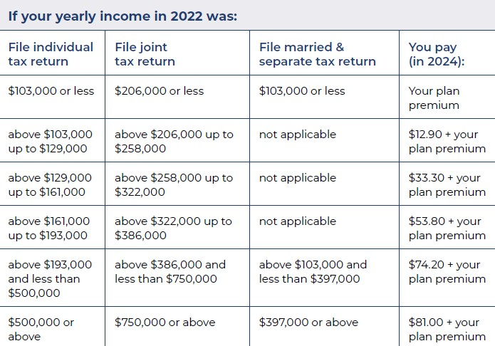
Income Related Monthly Adjustment Amount

Slide 16
Prescription Drug Plans
Enrollment Periods
Initial Enrollment Period (IEP)
3 months before, the month of, and 3 months after your 65th birthday
Special Enrollment Period (SEP)
Loss of creditable coverage
Permanent move
Many more
Annual Enrollment Period (AEP)
October 15 – December 7, effective January 1

Slide 17
Prescription Drug Plans
Late Enrollment Penalty
Added to monthly premium if beneficiary is without creditable coverage
Creditable coverage – coverage is expected to pay on average as much as the standard Medicare prescription drug coverage.
1% of “national base beneficiary premium” ($34.70 in 2024) multiplied by number of months eligible and without creditable coverage
Example: A client without creditable coverage for 10 months would have a penalty of ($.3470 x 10) $3.47/mo for as long as enrolled in prescription drug plan

Slide 18
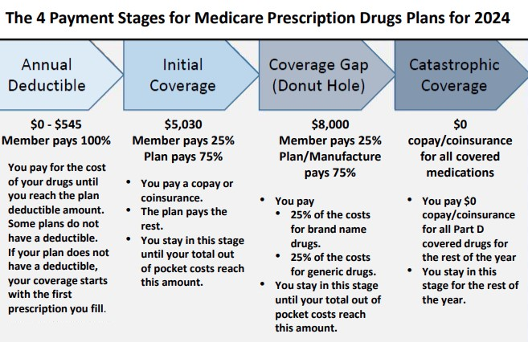

Slide 19
Prescription Drug Plan Changes In 2025
Part D Changes
Deductible will increase from $545 in 2024 to $590 in 2025
Coverage Gap (Donut Hole) eliminated
Annual out-of-pocket spending limit of $2,000
Possible $8,000 annual out-of-pocket limit in 2024
Prescription Payment Plan
Option to pay out-of-pocket drug costs in monthly installments

Slide 20
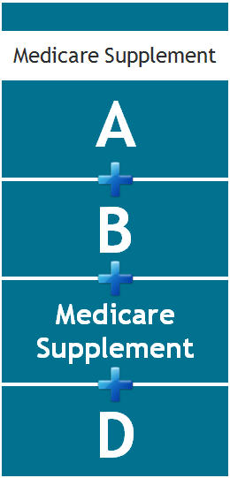
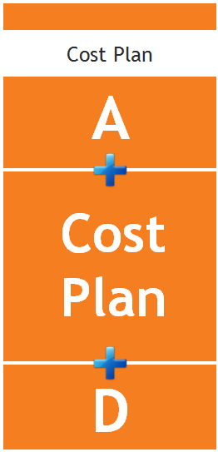
Filling In The Gaps

Slide 21
Filling In The Gaps
Eligibility
Must have Part A & B
Must reside in state/county plan is offered
Purchase drug coverage separately
Underwriting
No health questions during IEP or SEP
Must answer health questions outside of these enrollment periods
Carriers can offer an Open Enrollment Period (OEP)

Slide 22
Filling In The Gaps
Premiums can be determined by:
Age
Gender
Tobacco use
Health
Household discount

Slide 23
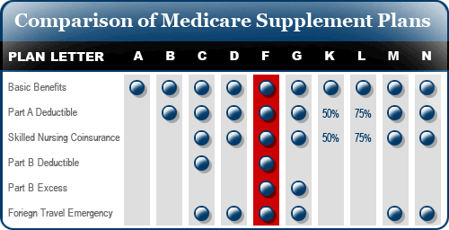
Filling In The Gaps
Plan benefits/types
Standardized Plans A-N
Plan F no longer available to newly eligible Medicare beneficiaries beginning 1/1/2020

Slide 24
Filling In The Gaps
Eligibility
Must have Parts A & B
Must reside in service area
Underwriting
No health questions
Premiums
One premium for everyone, regardless of age, gender, or tobacco status
Continue paying Medicare premiums

Slide 25
Filling In The Gaps
Plan benefits/types
Networks
Copays
Coinsurance
Out-of-pocket maximum
Additional Benefits
Do not retain original Medicare
Enrollment and disenrollment periods

Slide 26
Filling In The Gaps
Eligibility
Must have Parts A & B, or Part B only
Must reside in service area
Underwriting
One health question: Do you have End Stage Renal Disease (ESRD)?
Premiums
One premium for everyone, regardless of age, gender, or tobacco status

Slide 27
Filling In The Gaps
Plan benefits/types
Networks
Copays
Coinsurance
Out-of-pocket maximum
Travel
Additional Benefits
Retain original Medicare
No enrollment/disenrollment period
Can switch between plan options

Slide 28
Questions? {Agency Contact Info} {www.agencywebsite.com}
WE DO NOT OFFER EVERY PLAN AVAILABLE IN YOUR AREA. CURRENTLY WE REPRESENT [INSERT NUMBER OF ORGANIZATIONS] ORGANIZATIONS WHICH OFFER [INSERT NUMBER OF PLANS] PRODUCTS IN YOUR AREA. PLEASE CONTACT MEDICARE.GOV, 1-800-MEDICARE, OR YOUR LOCAL STATE HEALTH INSURANCE PROGRAM (SHIP) TO GET INFORMATION ON ALL OF YOUR OPTIONS.

